Slide 1
A MAJOR PROJECT
On
FACEMASK MONITORING SYSTEM
BACHELOR OF TECHNOLOGY
IN
COMPUTER SCIENCE AND ENGINEERING
BY
BIKKUMALLA RISHI PRANAY RAJ (17VE1A0512)
BHANDEKAR DINESH (17VE1A0511)
KAMAL PATEL (17VE1A0531)
THALLA ASHISH SAI (17UJ1A0522)
Under the Guidance of
Mrs. PULI . SRILATHA (ASSISTANT PROFESSOR)
ACADEMIC YEAR: 2017-2021

Slide 2

FACEMASK MONITORING SYSTEM
CONTENTS
PROBLEM STATEMENT
LITERATURE SURVEY
EXISTING SYSTEM and its DRAWBACKS
PROPOSED SYSTEM and its ADVANTAGES
HARDWARE AND software REQUIREMENTS
IMPLEMENTATION
ARCHITECTURE DESIGN
UML DIAGRAMS
QUERIES

Slide 3
PROBLEM STATEMENT
To develop an API so that one can monitor humans whether they are wearing masks or not through CCTVs and take effective measures to control the spread COVID-19.

Slide 4
LITERATURE SURVEY
R-CNN can’t be used in real time because it takes around 47 seconds for each test image and it takes huge amount of time to train the network as you would have to classify 2000 region proposals per image.
Fast R-CNN” is faster than R-CNN is because you don’t have to feed 2000 region proposals to the convolutional neural network every time
Both of the above algorithms(R-CNN & Fast R-CNN) uses selective search which is slow and time consuming process so they developed Faster R-CNN which has no selective search.
YOLO is incredibly fast but it’s not accurate.

Slide 5
EXISTING SYSTEM AND ITS DRAWBACKS
There is no proper way of monitoring facemasks on human. And there were only limited libraries to develop an application. So to check whether the person is wearing a mask or not we need a human assistance to monitor everyone and make sure they wear mask.
DRAWBACKS :
Manual detection
Time consuming process
Human effort needed

Slide 6
PROPOSED SYSTEM AND ITS ADVANTAGES
With the level of advancements in the technology we can see that may libraries have been developed. So with those libraries we can create many applications and API’s.
In this we’ll be developing an interface for the enterprise which is integrated with CCTV’s so that it detects humans with masks and without masks.
ADVANTAGES:
New step in automation
Reduced human efforts

Slide 7
REQUIREMENTS
Software Requirements:
Python 3.0 or above version
Required libraries in python (defined in “requirements.txt” file )
Tools used: Visual Code
Browser: Chrome, FireFox, Edge
Hardware Requirements:
Web-camera of at least 5MP
4GB RAM
500MB free space on disk storage
Operating System : Windows
Processor: 1.7GHz or above

Slide 8
IMPLEMENTATION
Requirement gathering
Designing
Coding
Testing
Integration

Slide 9
ARCHITECTURE DIAGRAM
Client UI
REST API
Face Detection
Mask-detection on faces
Camera Interface
Caffe Model and prototype
Model
Client
Server

Slide 10
DATA FLOW DIAGRAM
Human Faces
Camera
Individual Frames
Raw-data (frame)
Pre-Processing
Face Detection Model
Feature Extraction
Mask Detection Model
Classification
Binary Classification

Slide 11
DESIGN AND ANALYSIS
Start
Swagger UI
Select
Request dynamic video
Request image/video
Camera access
Facemask detection
Display results
Stop

Slide 12
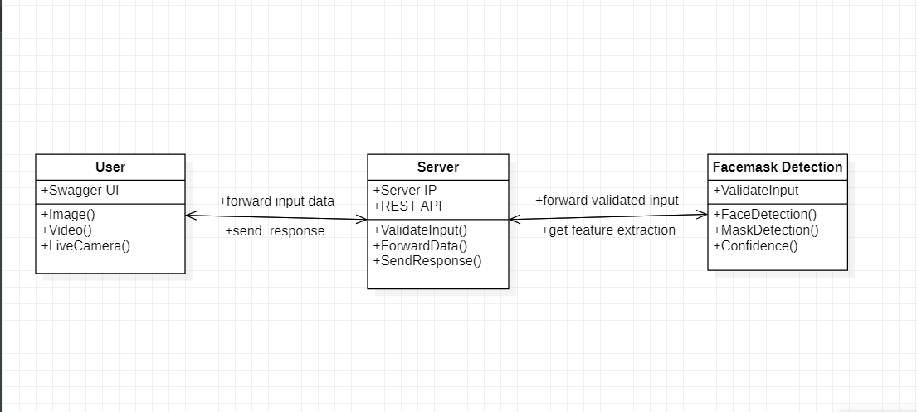
CLASS DIAGRAM

Slide 13
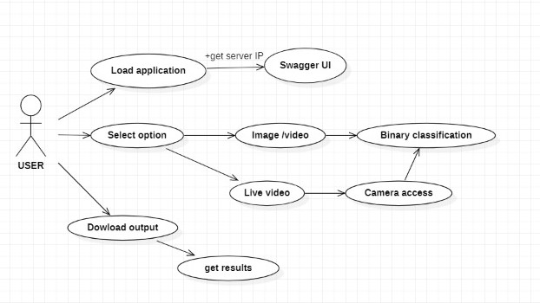
USE CASE DIAGRAM

Slide 14
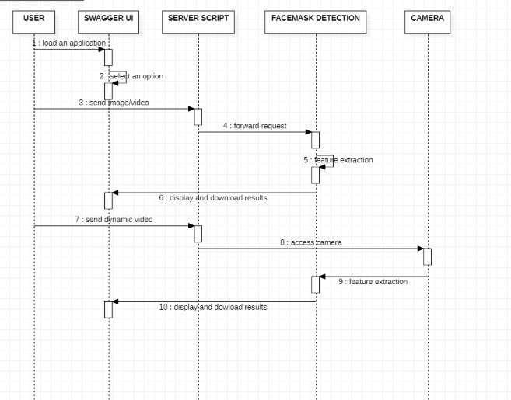
SEQUENCE DIAGRAM

Slide 15
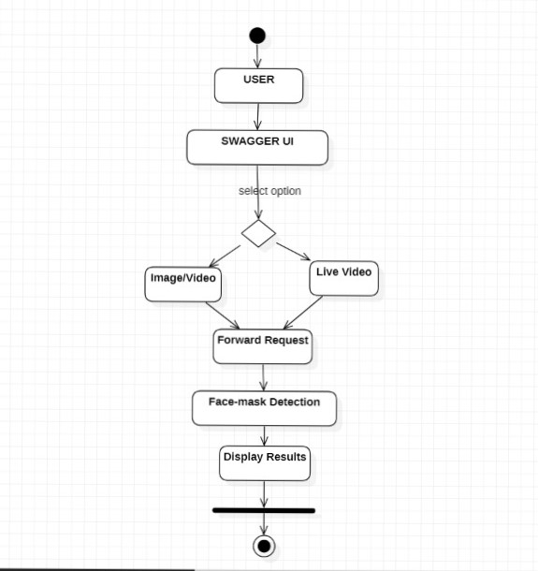
ACTIVITY DIAGRAM

Slide 16
Queries ??

